Slide 1

PHY110
ENGINEERING PHYSICS
Lecture #0
The kick start session

Slide 2

University Vision and Mission

Slide 3


To be a premier academic institution, recognized internationally for its contribution to industry and society through excellence in teaching, learning, research, internationalization, entrepreneurship and leadership.
VISION

Slide 4
To transform education through academic rigor, practical orientation and outcome-based teaching.
To develop and implement a relationship of cooperation between industry and academia.
To undertake impactful research addressing local, national and global challenges.
To prepare graduates to be lifelong learners with strong analytical and leadership skills.
To develop global professionals and entrepreneurs with innovative spirit, tolerance and desire to make a difference to the society.
MISSION

Slide 5
Programme Outcomes
PO1 : Engineering knowledge : Apply the knowledge of mathematics, science, engineering fundamentals, and an engineering specialization to the solution of complex engineering problems.
PO2 : Problem analysis : Identify, formulate, research literature, and analyze complex engineering problems reaching substantiated conclusions using first principles of mathematics, natural sciences, and engineering sciences.
PO3 : Design/development of solutions : Design solutions for complex engineering problems and design system components or processes that meet the specified needs with appropriate consideration for the public health and safety, and the cultural, societal, and environmental considerations.
PO4 : Conduct investigations of complex problems : Use research-based knowledge and research methods including design of experiments, analysis and interpretation of data, and synthesis of the information to provide valid conclusions.
PO5 : Modern tool usage : Create, select, and apply appropriate techniques, resources, and modern engineering and IT tools including prediction and modeling to complex engineering activities with an understanding of the limitations
PO6 : The engineer and society : Apply reasoning informed by the contextual knowledge to assess societal, health, safety, legal and cultural issues and the consequent responsibilities relevant to the professional engineering practice.
PO7 : Environment and sustainability : Understand the impact of the professional engineering solutions in societal and environmental contexts, and demonstrate the knowledge of, and need for sustainable development.

Slide 6
PO8 : Ethics : Apply ethical principles and commit to professional ethics and responsibilities and norms of the engineering practice.
PO9 : Individual and team work : Function effectively as an individual, and as a member or leader in diverse teams, and in multidisciplinary settings.
PO10 : Communication : Communicate effectively on complex engineering activities with the engineering community and with society at large, such as, being able to comprehend and write effective reports and design documentation, make effective presentations, and give and receive clear instructions.
PO11 : Project management and finance : Demonstrate knowledge and understanding of the engineering, management principles and apply the same to one’s own work, as a member or a leader in a team, manage projects efficiently in respective disciplines and multidisciplinary environments after consideration of economic and financial factors.
PO12 : Life-long learning : Recognize the need for, and have the preparation and ability to engage in independent and life-long learning in the broadest context of technological change.

Slide 7
Programme Specific Outcomes
PSO1 : Apply basic knowledge in the areas such as Software Engineering, Networking amp Security, Database Management Systems, Intelligent Systems, Operating Systems and System Architecture for building Software products.
PSO2 : Attain the ability to design and develop software based systems, evaluate and recognize potential risks and provide creative, economical and optimal solutions.
PSO3 : Provide effective and efficient real time solutions using attained knowledge in inter-disciplinary domains for societal benefits through projects.
PSO4 : Ability to adapt future technologies through acquired skills and knowledge to ideate, design, test and deploy solutions for different business environments.

Slide 8
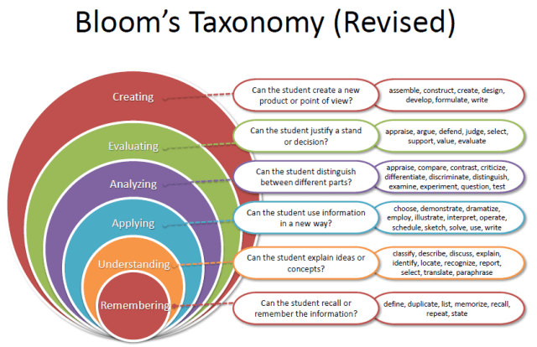
Revised Bloom’s Taxonomy

Slide 9
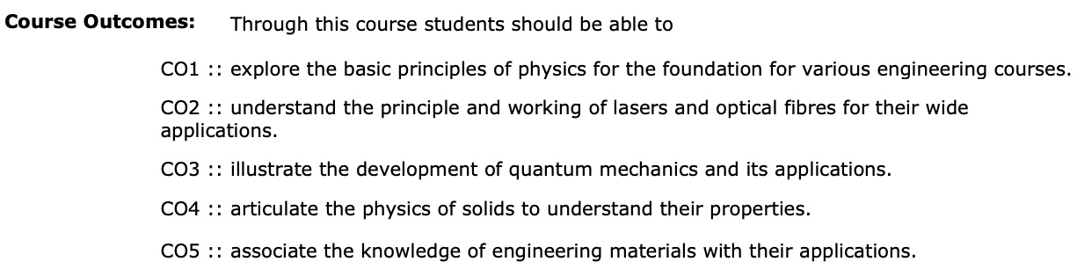
Course outcomes

Slide 10

What you will study here in this course?
Course Content

Slide 11

But how to find the syllabus in UMS ?
UMS log in >>UMS navigation >> Learning Management System>>Academic course syllabus>>syllabus files >> select the session >>PHY110

Slide 12
Syllabus

Slide 13
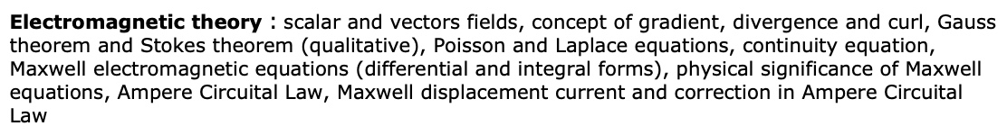


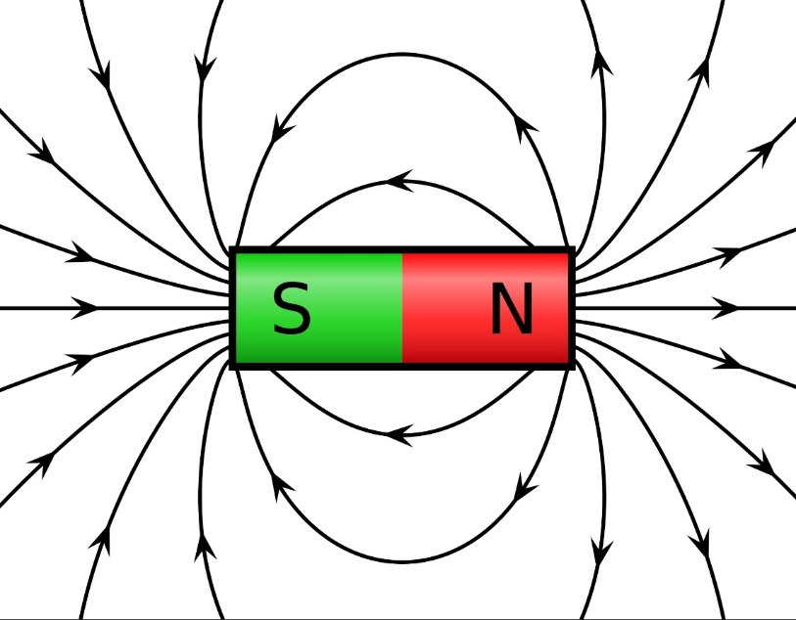
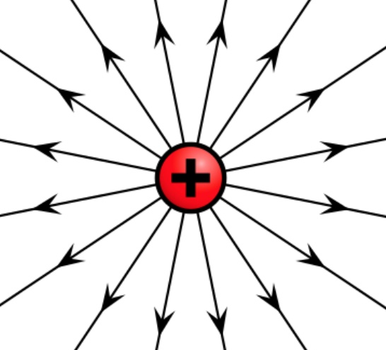
Unit I

Slide 14

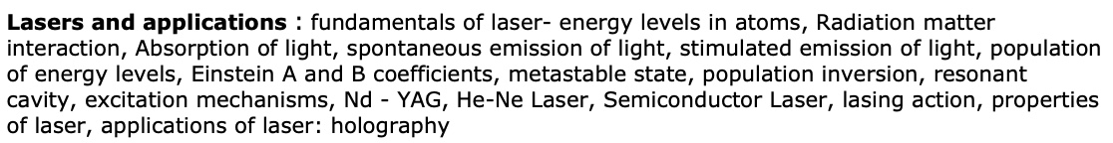

Unit II

Slide 15

Unit III

Slide 16
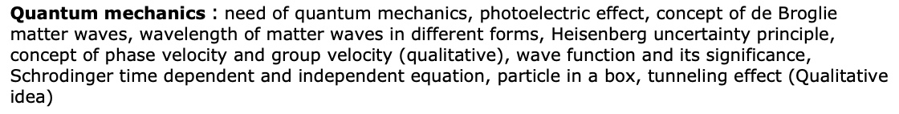
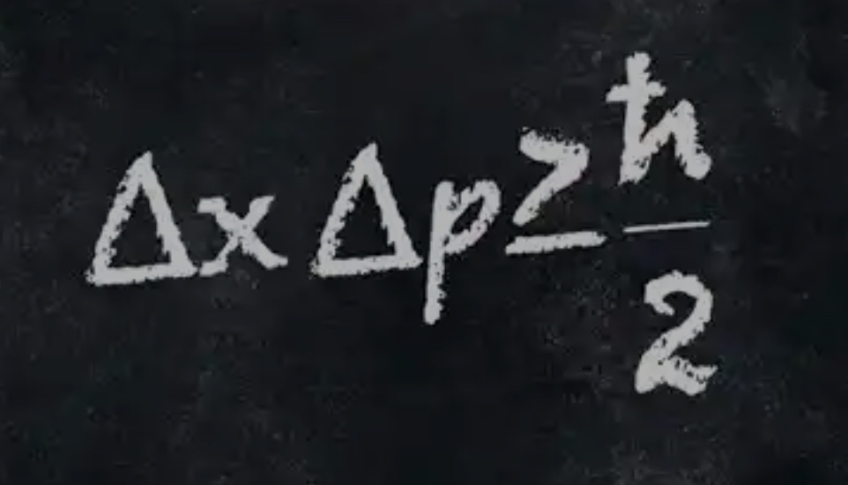
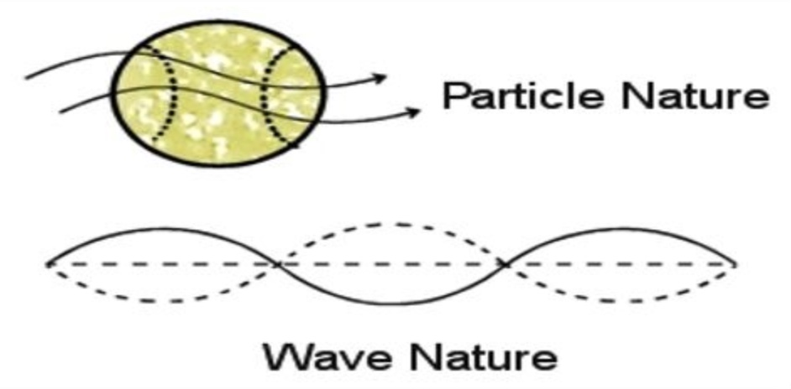
Unit IV

Slide 17
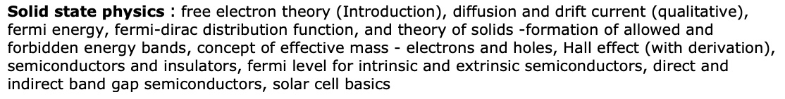
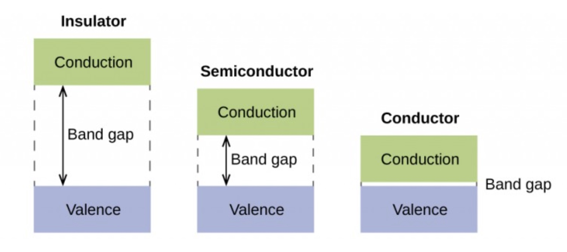
Unit V

Slide 18
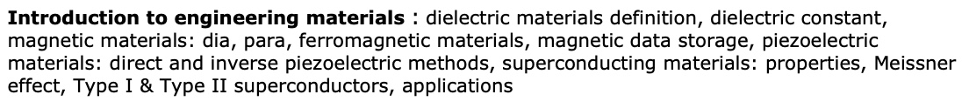

Unit VI

Slide 19

Text books and Reference Books

Slide 20
Course Orientation
COMPETITIVE EXAMINATION (Higher Education)
COMPETITIVE EXAMINATION (Civil Services)
KNOWLEDGE ENHANCEMENT

Slide 21
Assessment Model
L: 3.0 T: 0.0 P: 0.0 Cr: 3.0
Weightages:
Attendance: 5
CA: 25 (total CA - 3, 1 compulsory, best 1 in remaining 2)
MTT: 20 (Unit I,II and III)
ETT: 50 (Unit I to VI)

Slide 22

Check your understanding !
(Q and A with the students)

